Slide 1
The Math Behind Neural Networks
Backpropagation and Gradient Descent
Jack Paulson
01

Slide 2
Table of Contents
Neural network basics
The forward pass
Backpropagation
Gradient descent
01

Slide 3
Neural Network Basics
01

Slide 4
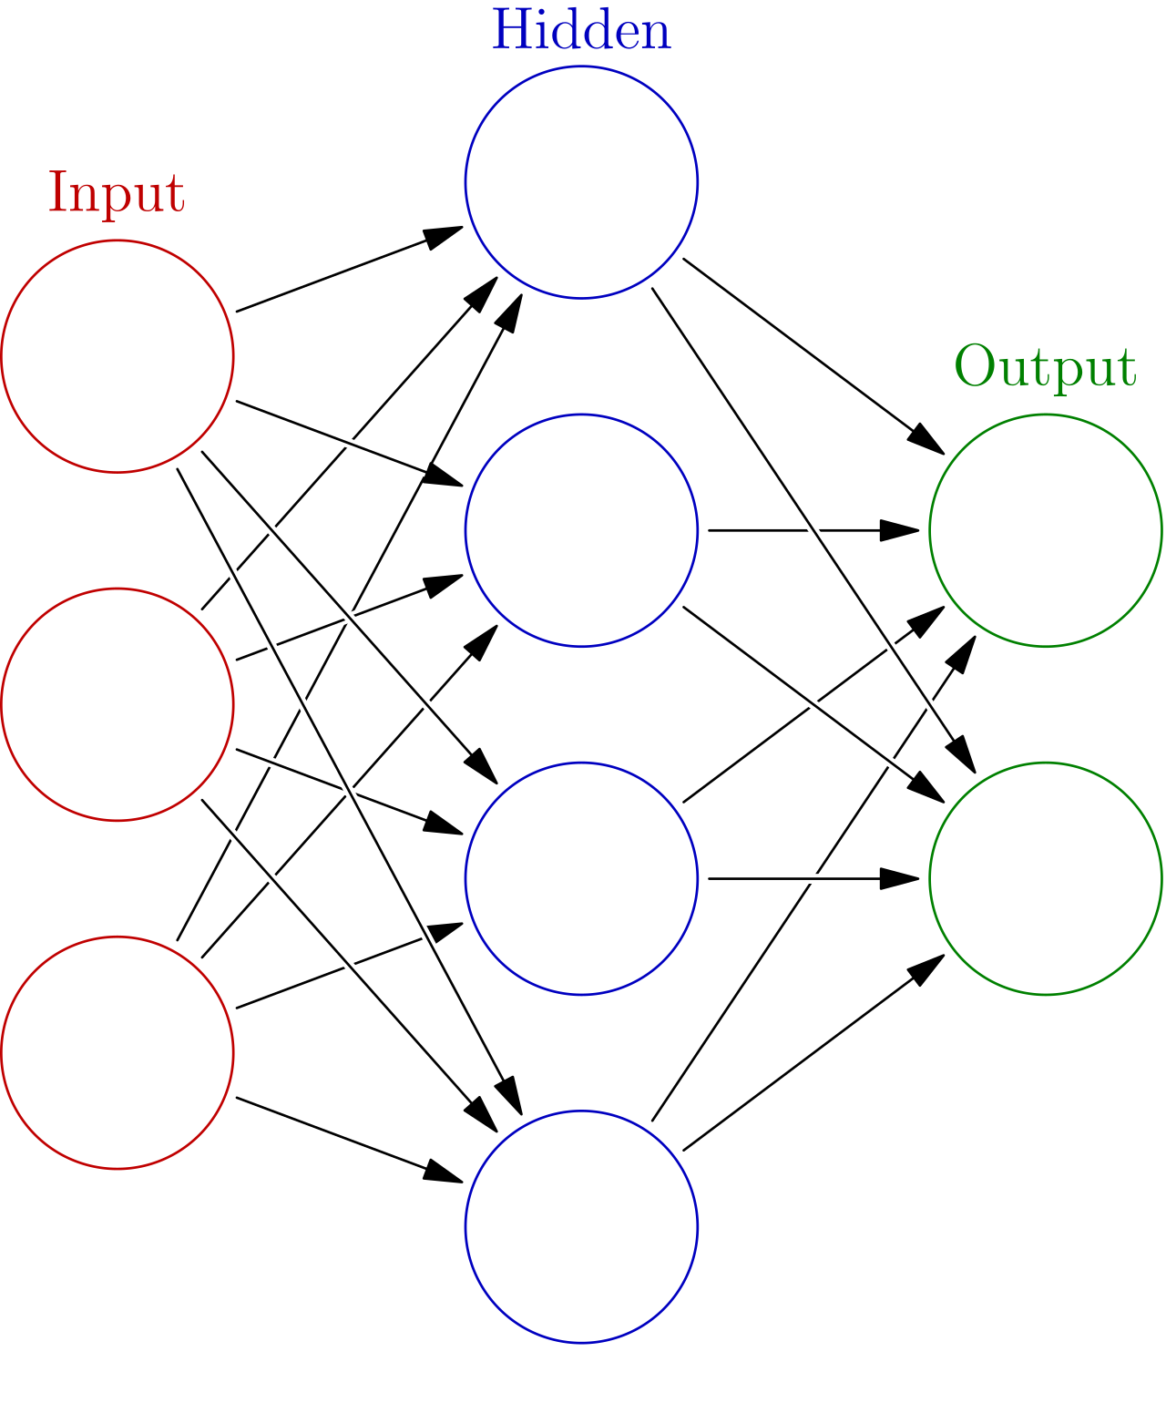
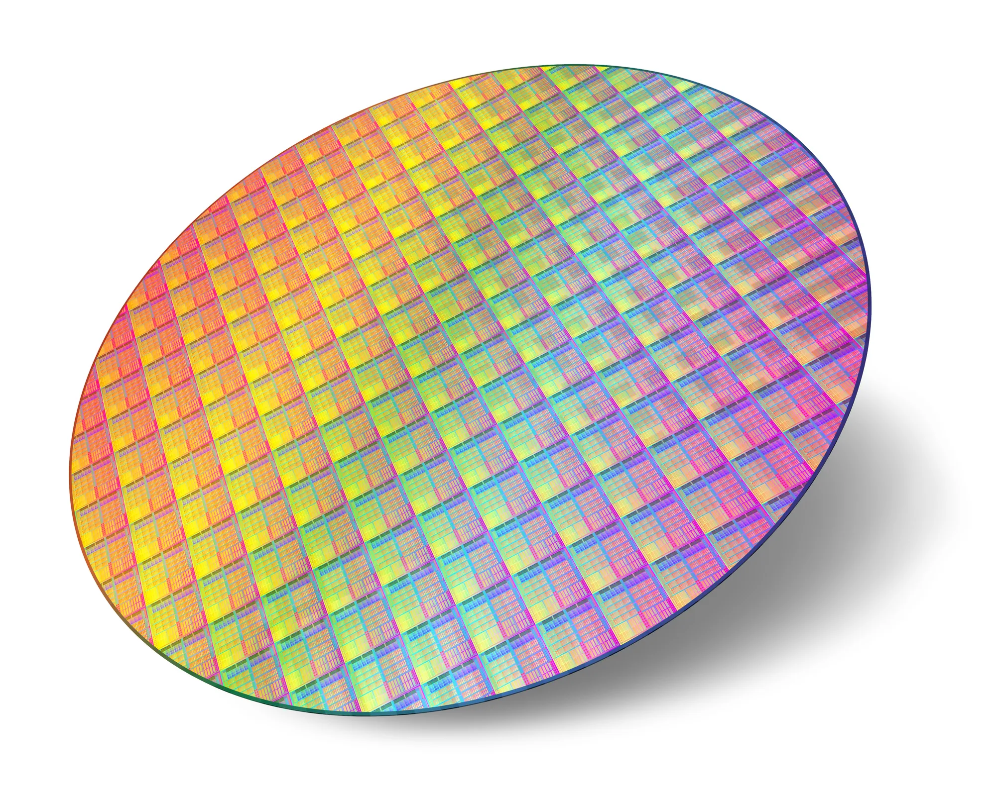

Slide 5
Predicting whether a wafer is defective
Three measured inputs
Temperature = 0.8 Production speed = 0.4 Contamination = 1.0
One known answer
This wafer is defective, so its target is y = 1.
The model’s job
Use the inputs to estimate the probability of a defect.
02
Notes:
How could we use manufacturing measurements to predict a defect?

Slide 6
Weights, biases, and hidden layers
Weights scale the inputs
Each connection has a weight. Its sign determines how that input affects z.
A bias shifts the weighted sum
Each neuron has its own bias, even when all its inputs are zero.
Hidden layers build intermediate combinations
Later layers use earlier activations to form the final prediction.
04

Slide 7
Forward Pass
01

Slide 8
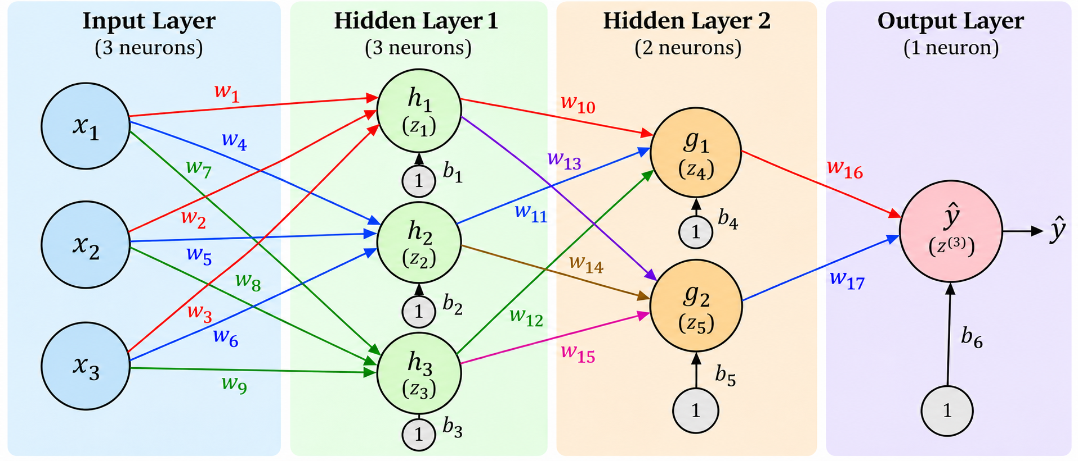
The network repeats the neuron calculation
x₁ = 0.8 Temperature
x₂ = 0.4 Production speed
x₃ = 1.0 Contamination level
Target: y = 1
Defective wafer
06
Notes:
Inputs enter three hidden neurons, then two hidden neurons, then one output.
Each connection carries a weight, and each non-input neuron has its own bias.

Slide 9
What one neuron calculates
1 Combine the inputs
z = w₁x₁ + w₂x₂ + w₃x₃ + b
2 Apply an activation function
a = σ(z)
z is the weighted sum.
The activation a becomes an input to the next layer.
03
Notes:
Neuron: the circles
Weights: the lines. . A weight is an adjustable coefficient.
Bias: A bias is an adjustable constant, like an intercept.
z is the value before activation and a as the value after activation. Sigma is the name of the activation function

Slide 10
One neuron, worked numerically
Row 1 = [0.10, 0.20, −0.10] x = [0.8, 0.4, 1.0]ᵀ
Matching entries | Weight | Input | Product
First pair | 0.10 | 0.8 | 0.08
Second pair | 0.20 | 0.4 | 0.08
Third pair | −0.10 | 1.0 | −0.10
z = w₁x₁ + w₂x₂ + w₃x₃ + b
z₁ = 0.08 + 0.08 − 0.10 + b₁ = 0.06
07
Notes:
Multiply each weight by its matching input, then add the products and the bias. - The DOT PRODUCT: multiply corresponding entries, then add the products.
Zero initial bias gives z1 = 0.06. Applying the sigmoid gives h1 about 0.515

Slide 11
Matrix multiplication combines a whole layer
W₁
x
b⁽¹⁾
z⁽¹⁾
0.10 | 0.20 | −0.10
−0.10 | 0.10 | 0.20
0.20 | −0.10 | 0.10
0.8
0.4
1.0
0
0
0
0.06
0.16
0.22
×
+
=
08
Notes:
Each row calculates a different neuron using the same input column.
Matching inner dimensions allow multiplication. The number of columns in the first matrix must equal the number of rows in the second matrix
The result is a three-entry column because there are three neurons.
Apply sigmoid element by element, giving h approximately [0.5150,0.5399,0.5548]^T

Slide 12
Matrix multiplication in Hidden Layer 2
W₂
h
0.5150
0.5399
0.5548
0.10 | −0.20 | 0.10
0.20 | 0.10 | −0.10
×
z₄ ≈ 0.05150 − 0.10798 + 0.05548 + b₄ = −0.00100
z₅ ≈ 0.10300 + 0.05399 − 0.05548 + b₅ = 0.10151
09
Notes:
The same rule operates on the previous activations rather than the original inputs.
W2 has two rows, so it produces two weighted sums.

Slide 13
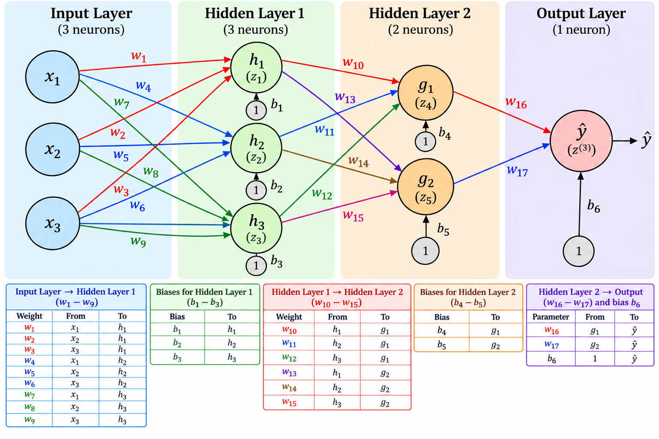
Matrix multiplication at the output
g
W₃
0.4997
0.5254
0.20 | −0.10
×
+ b₆
z₆ ≈ (0.20)(0.4997) + (−0.10)(0.5254) + 0
= 0.09994 − 0.05254 = 0.04740
The final sigmoid gives ŷ ≈ 0.5119, the predicted defective probability.
10
Notes:
The final layer has one row and therefore one weighted sum.
Add b6 and apply sigmoid to get 0.5119

Slide 14
The first prediction
51.2%
Predicted probability that this wafer is defective
Known target: y = 1
We want training to increase this example’s predicted probability.
11
Notes:
Prediction: The network outputs y=0.5119 meaning it assigns about a 51.2% probability that this wafer is defective.
Known answer: y=1 means this wafer actually is defective. A label of y=0 would mean it is not defective.
Training goal: Adjust the weights and biases so the prediction moves closer to y=1, assigning a higher probability to the correct outcome.
The 51.2% is not the model’s accuracy. It is the predicted probability for this single wafer. Accuracy measures how often a model correctly classifies a collection of examples.

Slide 15
Binary cross entropy loss
The target is 1, so increasing the prediction reduces this loss.
12
Notes:
Loss measures how poorly the prediction matches the known answer. Lower loss is better.
Y is the actual label, and y-hat is the predicted probability of a defect.
Since this wafer is defective, y=1. The second term becomes zero
Our prediction is 0.5119, giving a loss of 0.6697
Increasing the probability assigned to the correct answer reduces the loss.
Training adjusts the weights and biases to minimize this loss.

Slide 16
How the network learns
1. Forward pass
Use the current weights and biases to calculate a prediction
2. Loss
Compare the prediction with the known target
3. Backpropagation
Find how each parameter affects the loss
4. Gradient descent
Adjust the parameters using those derivatives
The learning rate controls the size of each update.
13

Slide 17
Backpropagation
01

Slide 18
The chain rule for one output weight
How does changing w₁₆ affect the loss?
∂L
∂L
∂ŷ
∂z₆
=
×
×
∂w₁₆
∂ŷ
∂z₆
∂w₁₆
Weight’s effect
on loss
Prediction’s effect
on loss
Weighted sum’s effect
on prediction
Weight’s effect
on weighted sum
Notes:
We want to know how a small change in w16 would affect the loss.
W16 connects hidden neuron g1 to the output. Changing it changes the weighted sum (neuron), which changes the prediction y-hat, which changes the loss
The chain rule multiplies these sensitivities to find the weight’s overall effect on loss.
Use partial derivatives because the loss depends on many weights and biases. We vary w16 while holding the other weights and biases fixed.
The derivative tells us which direction the loss moves when we increase the weight slightly.
Positive derivative: Increasing the weight increases the loss. So we decrease the weight to lower the loss.
Negative derivative: Increasing the weight decreases the loss. So we increase the weight to lower the loss.

Slide 19
Working backward through Hidden Layer 2
Every derivative measures sensitivity of the same final loss L.
1 Start at the output
∂L
δ₆ =
∂z₆
2 Follow g₁’s connection, then its sigmoid
∂L
Connection:
= δ₆w₁₆
∂g₁
Sigmoid:
δ₄ = (δ₆w₁₆) × g₁(1 − g₁)
Here, δ₄ = ∂L/∂z₄: sensitivity before g₁’s activation.
Notes:
This slide asks how a hidden neuron g1 affects the network’s final loss
Delta 6 measures how sensitive the loss is to the output’s weighted sum.
Focus on g1. It connects to the output through w16, so a small change in g1 changes the output’s weighted sum by w16 times that change.
By the chain rule, the partial derivative of g1 to the loss tells us how changing the activation g1 affects the loss.
Now go backward through g1’s sigmoid.
Multiply by the derivative of the sigmoid to measure how changing z4 (before activation), affects the los
Repeat the same process for g2

Slide 20
Finding the gradient of w₁₀
How does changing w₁₀ affect the loss?
∂L
∂L
∂z₄
=
×
∂w₁₀
∂z₄
∂w₁₀
Loss sensitivity
δ₄
Incoming activation
h₁
Notes:
We already worked backward through g1’s sigmoid and found delta4
Now we want to know how changing the incoming weight w10 affects the same final loss.
Apply the chain rule
This gives the loss sensitivity to w10, which gradient descent uses to update that weight.

Slide 21
Two paths contribute to the gradient of h₁
h₁ affects the loss through both g₁ and g₂.
1 Add the contributions from both paths
∂L
=
+
δ₄w₁₀
δ₅w₁₃
∂h₁
Path through g₁
Path through g₂
2 Multiply by h₁’s sigmoid derivative
δ₁ = (δ₄w₁₀ + δ₅w₁₃) × h₁(1 − h₁)
Notes:
Next, we work backward to h1 in Hidden Layer 1.
h1 affects the final loss through two paths: through g1 via w10, and through g2 via w13
The chain rule adds both contributions
Then we work backward through h1’s sigmoid
Delta1 measures how sensitive the same final loss is to z1, the weighted sum before h1’s activation.
The pattern repeats: add contributions from downstream paths, pass backward through the activation, then calculate the incoming weight gradients.

Slide 22
Gradient Descent
01

Slide 23
Gradient descent: updating a weight
Use the gradients from backpropagation to adjust the parameters.
∂L
w_{new}
=
w_{old}
−
η
×
∂w
New weight
Current weight
Learning rate
sets the step size
Gradient
from backpropagation
Positive gradient
Negative gradient
Decrease the weight
Increase the weight
Notes:
Backpropagation calculates how sensitive the loss is to each weight and bias (calculates the gradient). Gradient descent uses those derivatives to update the parameters.
A smaller learning rate gives a smaller step for the same gradient.
• For a positive gradient, increasing the weight increases loss, so gradient descent decreases the weight.
• For a negative gradient, increasing the weight decreases loss, so gradient descent increases the weight.
• Apply the same rule to each bias by replacing w with b.
• Calculate all gradients at the current parameter values, update all parameters, then run the next forward pass.

Slide 24
What’s Next?
01

Slide 25
What happens next?
1
Run another forward pass
Use the updated weights and biases to make new predictions.
2
Calculate new loss and gradients
Compare predictions with labels, then backpropagate again.
3
Repeat across the training data
Keep updating over many batches. One full pass is an epoch.
4
Check performance on unseen data
Monitor validation performance and test the final model separately.
Notes:
Evaluate the chosen final model on a separate test set to assess performance on unseen data.
Once trained, making a prediction requires only a forward pass.

Slide 26
Appendix
01

Slide 27
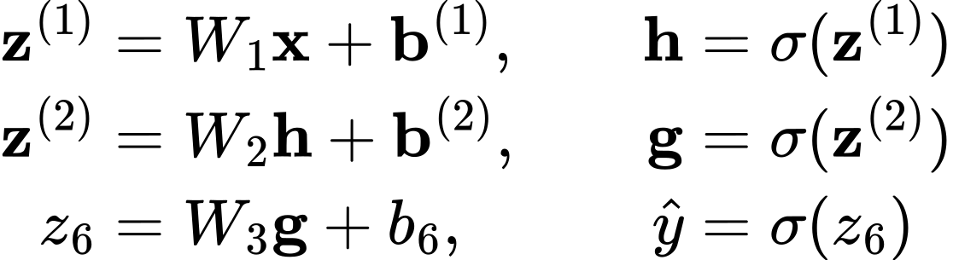
The forward pass in matrix form
Each layer multiplies its inputs by the weights, adds its biases, and applies the sigmoid function.
A04

